Slide 1
Private and Confidential
Establishing a Data Centre REIT on SGX
May 2026

Slide 2
Equity and REIT Market Update
Section 1

Slide 3
2026 – Markets once again demonstrate resilience and momentum, prevailing above geopolitical uncertainties
Markets are navigating significant uncertainty from geopolitical conflicts, inflation risks, tariff threats, and disruptive effects of AI in 2026.
Despite the downside macro risks, markets continue to remain resilient underpinned by sustained growth, having walked a similar path in 2025.
2 Apr: Liberation Day tariffs
12 May: 90-day pause in tariffs
Nov: Concerns over AI valuations
28 Feb: Middle East Conflict
7 Apr: Temporary Ceasefire
4.50
4.25
4.00
3.75
Key Market Movers in 2025
Key Factors to Watch in 2026
Tariff War since Liberation Day sparked market volatility, supply chain disruptions and geopolitical tension, but markets adapted with subsequent tariff pauses and trade negotiations
AI – the Hottest Investment Theme: AI-driven capex and tech sector spending fueled strong equity gains globally
Inflation & Monetary Policy: Persistent inflation and recession fears created volatility, with expectations of rate cut decisions at each FOMC meeting driving markets
Closer to home, MAS Equities Market Review Group announced support measures to enhance SGX equities market, reviving market vibrancy
Geopolitical Conflicts have taken center stage with recent military action involving US and Iran, resulting in heightened volatility and moderating expectations of global economic growth
AI as Market Driver: Sustained AI capex (eg tech giants committing US$650 billion in 2026) to underpin growth, earnings, and equity markets globally, possibly competing against traditional macro factors
Rate Cut Trajectory: Fed expected to hold rates steady due to renewed inflation risk as concerns around energy prices mount
Underlying Economic Health: Softening labor market and overall growth projections, potentially offset by strong balance sheets and sector specific growth (eg AI)
Source: Bloomberg, Factset as at 04 May 2026

Slide 4
Global macro overview and outlook
US Inflation Outlook
Volatility index
Inflation has moderated globally, generally moving closer to respective central bank targets. However, upside risk has heightened back with the ongoing conflicts leading to energy price surge
Market volatility normalizes as diplomacy overtakes military action in the Strait of Hormuz, while worries of protracted peace negotiations linger
Market Expectations of Fed Funds Rate
US 10-year Treasury yields
Rates are expected to remain “higher-for-longer” on war-driven inflation risks, as energy prices remain elevated
US 10Y yield inched up from the 4.0% level before the conflict to current 4.3% in view of inflation risk
Current Fed Funds Rate Target Range: 3.50% - 3.75%
Period | Expected # Hikes / (Cuts)
Jun 2026 | (0.0)
Jul 2026 | (0.1)
Sep 2026 | (0.0)
Oct 2026 | 0.1
Dec 2026 | 0.3
Jan 2027 | 0.5
Mar 2027 | 0.6
Source: Bloomberg, Factset as at 04 May 2026

Slide 5
Singapore equity market gained momentum in 2025 - YTD 2026 supported by whole-of-ecosystem market initiatives, with both deal volume and trading liquidity up significantly
SGX saw a strong recovery supported by multiple measures from MAS / SGX encompassing major structural and regulatory reviews in 2025.
Singapore indices have remained resilient, and the STI has outperformed the S&P500 since 2025 to date
19 Nov: Completion of review.
2nd batch of fund managers under EQDP. Major new initiatives launched: SGX-Nasdaq Dual Listing Bridge and a S$30m Value Unlock" Package.
12 Feb: EQDP program budget increased from S$5.0bn to S$6.5bn following Budget 2026
21 Feb: 1st set of measures announced by MAS Review Group
15 May: Consultation launched to streamline prospectus disclosure requirements
21 Jul: MAS appoints 1st batch of fund managers under S$5.0bn EQDP
Singapore 2025 ECM deal volume nearly doubled to US$4.3b. YTD 2026 deal volume closing in on 2025 full-year volume driven by a resurgence in both primary and secondary offerings
SGX average monthly turnover (S$’bn) rose 34% between 2025 and YTD 2026 as investor sentiment strengthened
(USD billion)
YTD 2026 Turnover: S$2.0bn ( +34%)
2025 Turnover: S$1.5bn ( +18%)
2024 Turnover: S$1.2bn
Source: Bloomberg, Factset as at 04 May 2026

Slide 6
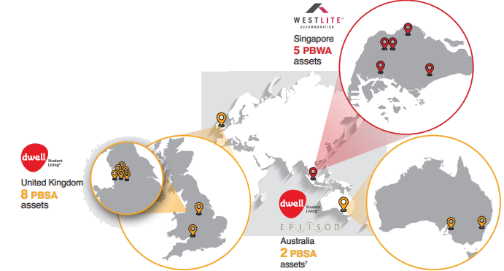
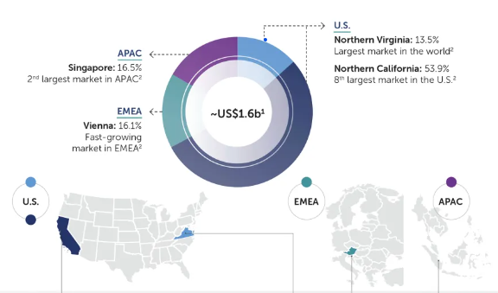
Resurgence of S-REIT IPO market activity in 2025 and 2026, after a hiatus of three years …
SGX S-REIT Initial Public Offerings
Seletar Aerospace Park
Date | Trusts | Proceeds | DBS
2026 | UI Boustead REIT | S$974m
2025 | Centurion Accommodation | S$771m
2025 | NTT DC | US$773m
2021 | Digital Core | US$600m
2021 | Daiwa House Logistics | S$464m
2020 | United Hampshire | US$310m | -
2020 | Elite Commercial | £131m | -
2019 | Lendlease Global Comm | S$740m
2019 | Prime US | US$628m
2019 | Eagle Hospitality | US$566m
2019 | ARA US Hospitality | US$451m
2018 | Sasseur | S$396m
2017 | Cromwell European | €866m
2017 | Keppel-KBS US | US$476m
2017 | NetLink NBN | S$2,374m
2017 | Dasin Retail | S$154m
2016 | EC World | S$364m
2016 | Frasers Logistics & Industrial | S$928m
2016 | Manulife US | US$470m
UI Boustead REIT
Singapore
21 assets
Changi Airport
23 logistics and industrial assets across SG and JP,
valued at S$1.9bn
Japan
2 assets
Tuas Mega Port
Central Business District
Logistics
Business Space
Hi-Specs Industrial
General Industrial
Major Expressways
Centurion Accommodation REIT
14 PBWA and PBSA across SG, UK and AU, valued at S$1.8bn
NTT DC REIT
6 data centres across US, EU and SG valued at US$1.6bn

Slide 7
… while momentum continues in S-REIT market activity
2023 | Trusts | EFRs | Proceeds | DBS
 | Elite Commercial | Preferential | £28m | -
 | CapitaLand Ascott | Placement + Pref | S$303m
 | IREIT Global REIT | Preferential | S$76m | -
 | CapitaLand India | Preferential | S$150m
 | AIMS APAC REIT | Placement + Pref | S$100m
 | Mapletree Industrial | Placement | S$205m
 | Capitaland Ascendas | Placement | S$500m
 | Keppel Infrastructure | Placement + Pref | S$300m
 | Mapletree Logistics | Placement | S$200m
 | ESR-Logos | Placement + Pref | S$300m
 | Total: |  | S$2,183m
SGX S-REIT Equity Fund Raisings
2026 | Trusts | EFRs | Proceeds | DBS
 | UI Boustead REIT | IPO | S$974m
 | CapitaLand Int Comm | Placement | S$750m
 | CapitaLand Ascendas | Placement + Pref | S$904m
 | Lendlease Global | Pref | S$197m
 | CapitaLand India | Placement | S$150m
 | Keppel REIT | Pref | S$886m
 | Total: |  | S$3,861m
(S$ bn)
2025 | Trusts | EFRs | Proceeds | DBS
 | Centurion Accommodation | IPO | S$771m
 | NTT DC | IPO | US$773m
 | Lendlease Global | Placement | S$280m
 | Keppel REIT | Placement | S$113m
 | Prime US REIT | Placement | US$25m
 | Keppel DC REIT | Pref | S$405m
 | CapitaLand Int Comm | Placement | S$600m
 | Elite UK | Placement | £4.0m | -
 | CapitaLand Ascendas | Placement | S$500m
 | Fraser Centrepoint | Placement + Pref | S$421m
 | Total: |  | S$4,128m
2024 | Trusts | EFRs | Proceeds | DBS
 | Keppel DC REIT | Placement + Pref | S$1,086m
 | Parkway Life REIT | Placement | S$180m
 | CapitaLand Int Comm | Placement + Pref | S$1,107m | -
 | Keppel Infra Trust | Placement | S$200m
 | Digital Core | Placement | US$120m
 | Frasers Centrepoint | Placement | S$200m
 | Total: |  | S$2,928m
Note: Based on GBPSGD of 1.810, USDSGD of 1.29 and EURSGD of 1.543 for transactions denominated in a foreign currency

Slide 8



Comparing Singapore-listed data centre REITs
NTT DC REIT
(Rebased to 100 as at IPO on 14 Jul 2025)
Price (Rebased to 100 as at 1 Jan 2025)
Price (Rebased to 100 as at 1 Jan 2025)
Price (Rebased to 100 from IPO as at 14 Jul 2025)
Turnover
(S$m)
Turnover
(S$m)⁽¹⁾
Turnover
(S$m)⁽¹⁾
YTD +7.8%
YTD -11.2%
IPO till date -1.0%
Market Cap: S$5.7b | ADT (1m): S$26.0m
Market Cap: US$667m | ADT(1m): US$1.3m
Market Cap: US$1.0b | ADT(1m): US$3.2m
Keppel DC REIT has traded mostly in line with the wider FTSE ST REIT Index, while NTT DC REIT and Digital Core REIT have underperformed the index due to stock-specific reasons. Notwithstanding adjustments to the Fed rate cut cycle given the ongoing conflict in Iran, momentum for the REIT sector, and data centers in particular, has been positive
Market liquidity and activity continues to remain healthy. We expect data centre REITs continuing to register healthy daily average turnovers as attention continues to be focused on the broader AI sector
Source: Bloomberg as at 04 May 2026 (1) Assuming USDSGD of 1 : 1.32

Slide 9
Analysts remain bullish on the data centre REITs backed by strong rental growth, accretive acquisitions and lowering funding costs
Current Price | S$2.35 | US$0.51 | US$0.98
Bloomberg 12M Target Price | S$2.64 | US$0.71 | US$1.27
Bloomberg Consensus Rating (Buy / Hold / Sell) | 15 / 1 / 0 | 5 / 0 / 0 | 4 / 0 / 0
Latest Analyst Commentary on Operating Performance
Strong 1Q26 update with 13.2% DPU increase, reinforcing the its positioning as a high-quality, structurally supported
Steady 1Q26, with flat distributable income with the absence of income from Linton Hall since 2H25, offset by acquisitions, lower interest rate and rental reversions
Next key catalyst will be the anticipated enhancement to the management fee structure, targeted in next 2 quarters
Strong positive rental reversions of +51%, indicating positive leasing spreads – to continue to support near-term earnings
Encouraging Leasing momentum with USD3.0m of annualised rent signed at +44% cash rental reversion
Renewed lease with its Sponsor at SG1 at impressive 23% reversion, and further fixed 5% annual escalation over next 2 years
Further uplift to analyst’s projections to come from accretive acquisitions given KDCREIT’s low gearing and low WACC
Linton Hall remains a meaningful embedded earnings re-rating catalyst ahead of its expected lease commencement in December 2026.
Successful backfilling at CA1 and CA3 assets, and new leasing incentive scheme demonstrate proactive asset management
KDCREIT may face higher barriers to entry and stiffer competition from international operators/funds seeking data centre assets
Near-term earnings outlook looks stable with the bulk of lease expiring in FY26 already renewed.
Solid fundamentals, healthy leasing momentum, and positive rental reversions
Source: Bloomberg and latest analyst reports as at 04 May 2026

Slide 10

[ ]
A ‘two-tier’ market for data centre REITs, as investors become discerning of data centre location, quality and leasing performance
High-specs data centres designed to hyperscale requirements will command premium valuations
Reasons for Keppel DC REIT’s premium valuation
Comparison against other DC REITs
Asia focus – 66% of portfolio anchored by assets in Singapore
Strong rental reversions of +51% in 1Q26
Access to Sponsor’s pipeline and track record of successful execution
Significant debt headroom with low WACC, positioned for further accretive acquisitions
Size, scale and index inclusion given KDC REIT is an STI Index constituent
Higher vacancies in US data center assets
A diversified REIT with industrial and data center assets
Singapore industrial assets supports earnings visibility
Earnings drag due to major refurbishment of Linton Hall
Potential for re-rating when lease commences in Dec 2026
Healthy debt for further accretive acquisitions
Certain hyperscale and non-hyperscale rents remain significantly below market
Pending realignment of management fees
Healthy leasing momentum
Positive rental reversions
5.4%
Average for DC pure-plays
(KDC, DC, NTT)
(for reference)
4.6%
6.1%
6.9%
7.6%
CY2026 DPU Yield
S-REIT Sector Averages:
5.9% (Retail)
6.4% (Industrial, Hospitality)
5.9% (Office)
5.2% (Healthcare)
5.5% (Mixed)
6.1% (Living)
Source: Bloomberg as at 24 April 2026. Latest analyst reports as at 30 April 2026
Note: Chart not to exact scale

Slide 11
[Hong Kong Equity Capital Market Update]
Section [ ]

Slide 12
Hong Kong Equity Capital Markets Recap – 2026YTD
2025
2026
HK team updated
Regional ECM deal volume¹
HK ECM deal volume 2021 – 2026YTD
US$’bn
US$’bn
57%
112.5 | 23.2 | 17.8 | 18.8 | 82.2 | 3.1 | 16.7
2026YTD
IPO: 20.9
Placement: 14.7
Rights Issue: 0.4
2025 Same Period
IPO: 8.4
Placement: 16.1
Rights Issue: 0.5
85%
44%
24%
63%
20%
596%
43.7%
Northbound vs Southbound Monthly Inflow³
Hong Kong Market Liquidity 2021 – 2026YTD
HK$’bn
US$’bn
2025 Avg: US$32.0b
2021 Avg: US$21.4b
2024 Avg: US$16.9b
-6% QoQ²
2022 Avg: US$15.9b
2023 Avg: US$13.4b
Source: Bloomberg, Dealogic, as of 20 May 2026
QoQ Comparison: 1Q 2026 vs 2QTD 2026
Exchanges have stopped releasing daily Northbound data since 19 August 2024

Slide 13
Hong Kong IPO Trends – 2026 YTD
HK team updated
Next 12-Month Indices Forecast
2026YTD IPO Performance
Index | YTD Return % | May 20 Close Price | Analyst 12M Target | Further Upside %
S&P 500 | 8.6% | 7,433 | 8,609 | 15.8%
Straits Times | 8.6% | 5,045 | 5,428 | 7.6%
Shanghai Comp | 4.9% | 4,162 | 5,027 | 20.8%
Hang Seng | 0.1% | 25,651 | 32,488 | 26.7%
HS China Enterprises | -3.5% | 8,605 | 11,162 | 29.7%
# | Listing Date | Ticker | Name | Deal Size (US$’mn) | Sector | 1st Day Return | Offer to Date Return
1 | 31-Mar-26 | 0664 | Tonghifu | 57 | Consumer | -49.2% | -68.5%
2 | 31-Mar-26 | 3625 | Shanghai FourSemi | 61 | TMT | 100.0% | 196.8%
3 | 30-Mar-26 | 2726 | Epiworld International | 209 | TMT | 35.1% | 37.8%
4 | 30-Mar-26 | 6636 | Shandong Extreme Vision | 64 | TMT | 150.0% | 144.6%
5 | 30-Mar-26 | 2526 | Diagens Biotechnology | 101 | Healthcare | 111.7% | 215.0%
6 | 30-Mar-26 | 1021 | Huayan Robotics | 202 | Industrials | 8.2% | 4.6%
7 | 24-Mar-26 | 2632 | Jiangsu New Vision | 92 | Consumer | -36.9% | 170.4%
8 | 24-Mar-26 | 2729 | Zhejiang Galaxis Technology | 78 | TMT | 84.3% | 95.1%
9 | 23-Mar-26 | 2701 | Nsing Technologies | 131 | TMT | 4.2% | 38.0%
10 | 23-Mar-26 | 3355 | FS.com | 243 | TMT | 13.6% | 4.1%
11 | 20-Mar-26 | 1989 | Delton Technology | 422 | TMT | 33.6% | 139.3%
12 | 10-Mar-26 | 3268 | MeiG Smart Technology | 149 | TMT | 1.5% | -11.6%
13 | 09-Mar-26 | 2715 | Estun Automation | 190 | Industrials | -16.0% | -0.4%
14 | 09-Mar-26 | 2692 | Shenzhen Zhaowei | 244 | Industrials | 2.4% | 3.5%
15 | 09-Mar-26 | 2649 | ALSCO Pooling | 29 | Industrials | -43.6% | -64.6%
16 | 13-Feb-26 | 2706 | Beijing Haizhi Technology | 97 | TMT | 242.2% | 115.1%
17 | 13-Feb-26 | 9981 | Shenzhen Woer | 360 | TMT | 2.9% | -26.9%
18 | 11-Feb-26 | 470 | Wuxi Lead Intelligent | 633 | Industrials | 0.0% | 15.1%
19 | 10-Feb-26 | 2720 | Ridge Outdoor International | 44 | Consumer | 102.3% | 98.9%
20 | 10-Feb-26 | 600 | Axera Semiconductor | 383 | TMT | 0.0% | -25.2%
 |  |  | Average | 189 |  | 37.3% | 54.1%
 |  |  | Median | 140 |  | 6.2% | 26.5%
ECM¹ Activity 2026YTD vs. 2025 Same Period
2026YTD
ECM Volume: US$36.0B
2025 Same P.
ECM Volume: US$25.0B
Source: Bloomberg, as of 20 May 2026
ECM deal volume includes IPO that have been priced but pending trading, and secondaries that have been announced but pending completion

Slide 14
HK is the #1 IPO Market Globally and 2nd Most Active Geography for All ECM Issuance
HK team updated
#1 in IPO Volume
Top 3 in All ECM Volume
Top 3 in Follow-on Issuance
Ranking | Exchange² | No. of Deals (#) | Deal Value (US$mm)^{1,3} |  | Ranking | Exchange² | No. of Deals (#) | Deal Value (US$mm)^{1,3} |  | Ranking | Exchange² | No. of Deals (#) | Deal Value (US$mm)^{1,3}
1 | Hong Kong (HKEX) | 38 | 13,257 |  | 1 | NASDAQ | 311 | 61,148 |  | 1 | NASDAQ | 292 | 55,240
2 | NASDAQ | 19 | 5,908 |  | 2 | New York (NYSE) | 124 | 50,337 |  | 2 | New York (NYSE) | 108 | 44,788
3 | India (NSE/BSE) | 77 | 5,601 |  | 3 | Hong Kong (HKEX) | 157 | 30,551 |  | 3 | Hong Kong (HKEX) | 119 | 17,295
4 | New York (NYSE) | 16 | 5,549 |  | 4 | Euronext | 79 | 15,370 |  | 4 | Japan (JPX) | 50 | 12,705
5 | Euronext | 8 | 5,144 |  | 5 | Japan (JPX) | 62 | 12,999 |  | 5 | Switzerland (SIX) | 6 | 12,246
6 | Shanghai (SSE) | 10 | 2,162 |  | 6 | India (NSE/BSE) | 127 | 12,608 |  | 6 | Euronext | 72 | 10,235
7 | Shenzhen (SZSE) | 6 | 1,141 |  | 7 | Switzerland (SIX) | 6 | 12,246 |  | 7 | India (NSE/BSE) | 50 | 7,008
8 | Singapore (SGX) | 3 | 967 |  | 8 | Canada (TSX) | 176 | 7,768 |  | 8 | Canada (TSX) | 168 | 7,006
9 | Malaysia (Bursa) | 11 | 852 |  | 9 | Shanghai (SSE) | 40 | 7,454 |  | 9 | London (LSE) | 112 | 6,351
10 | Beijing (BSE) | 19 | 830 |  | 10 | London (LSE) | 114 | 6,368 |  | 10 | Australia (ASX/NSX/SSX) | 206 | 5,453
Sources: Dealogic as of 31 Mar 2026
Excludes SPAC ECM transactions
Respective exchanges comprise all boards / markets consolidated under the exchange
The deal value of ECM transactions by HK / US dual-listed issuers is fully attributed to both HK and the US exchanges

Slide 15






Hong Kong – #1 IPO Venue Globally in 2026 Q1
HK team updated
. .
Top IPO Venue With Multiple Drivers
Overwhelming Investor Interest With Robust Aftermarket Performance
29% 14x
Average Share Price Average Institutional Performance^{2,3} 1-month Subscription²
862x
Average Retail Subscription²
#1
IPO Volume
Globally¹
Second Highest
Q1 IPO Volume
in History
21%
IPOs Including Upsize Option⁴
US$38mm
Average Current 3M ADT^{2,5}
Substantial
International
Participation
US$13.3bn
IPO Proceeds
(35% of 2025 IPO
Proceeds)
3 out of
5 Largest IPOs Globally
Multiple Successes With 10 US$500mm+ HK IPOs Priced in 2026 Q1
. Company Deal Size US$1.5bn | Sector Consumer | Deal Highlights Second largest consumer IPO in Asia in the last 5 years
US$1.4bn | Consumer | Largest beverage IPO in Asia in 2026YTD
US$1.0bn | TMT | Largest semiconductor HK IPO in the last 20 years
US$711mm | TMT | Largest ever IPO globally for a PCB⁶ equipment company
US$711mm | TMT | Largest ever LLM⁷ IPO and one of the first batch globally
US$691mm | TMT | Second largest semiconductor IPO globally
US$683mm | TMT | Third largest semiconductor IPO globally
US$642mm | TMT | Second largest LLM⁷ IPO and one of the first batch globally
US$633mm | Industrials | Second largest battery manufacturing IPO in the last 3 years
US$541mm | Consumer | Largest discount snack chain HK IPO
55% TMT / AI
27% Consumer
14% Industrials / New Energy
15
A-to-H IPOs
Sources: Bloomberg and Dealogic as of 31 Mar 2026
Excludes SPAC IPOs
Includes HK IPOs with deal size of US$100mm or above
Represents aftermarket performance since listing if less than 1 month of listing history
Includes HK IPOs with deal size of US$50mm or above
ADT since listing if less than 3 month of listing history
PCB: Printed Circuit Board
LLM: Large Language Model

Slide 16
International Investors Increasingly Active in Cornerstone Investments
HK team updated
International investors increasingly active in HK IPOs, participating in c.75% of deals and accounting for 40% of the most active cornerstone investors
High quality international long-onlys and SWFs have been amongst the most active investors in 2026, favouring sizeable consumer and new economy growth companies
International Investors Are Increasingly Active and Favour Consumer and TMT Companies
International Investors Are Among the Most Active Cornerstone Investors in HK IPOs¹ in 2026 Q1
# | Investor | Region | Investor Type | Aggregate Cornerstone Investment (US$mm) | # HK IPOs Cornerstoned
1 | JSC International² | China | Government Fund | 226 | 3
2 | UBS GAM | Switzerland | Long-only | 226 | 7
3 | Charoen Pokphand | Thailand | Strategic | 200 | 1
4 | Aspex | Hong Kong | Multi-strategy | 177 | 3
5 | AI-Rayyan / QIA | Qatar | SWF | 150 | 1
6 | Boyu | China | PE/VC | 135 | 3
7 | Yunfeng Investments | China | PE/VC | 116 | 2
8 | Temasek | Singapore | SWF | 115 | 2
9 | Taikang Life | China | Insurance | 112 | 6
10 | Fidelity International | US | Long-only | 110 | 2
11 | Tencent | China | Strategic | 100 | 3
12 | Xiamen Advanced Manufacturing Fund | China | Government Fund | 99 | 1
13 | Blackrock | US | Long-only | 95 | 2
14 | Hillhouse | China | PE/VC | 95 | 4
15 | GIC | Singapore | SWF | 90 | 1
16 | Alibaba | China | Strategic | 85 | 2
17 | ADIA | Abu Dhabi | SWF | 80 | 2
18 | Greenwoods | China | Multi-strategy | 78 | 3
19 | Janchor Fund | Hong Kong | Multi-strategy | 77 | 2
20 | GF Fund | China | Long-only | 77 | 3
HK IPOs¹ with International Cornerstone Investors Since 2022
100%
50%
0%
Sector Breakdown of Cornerstone Investments in HK IPOs¹ (by US$bn) Chinese Investors International Investors
 |  |  | 63% | 74%
 |  | 47%
29% | 37%
2022 | 2023 | 2024 | 2025 | 2026 Q1
16%
3%
_{7%} 3%
40%
17%
64%
50%
TMT Consumer Industrials
Healthcare
Sources: HKEX, Bloomberg and Refinitiv
Includes HK IPOs with deal size of US$100mm or above
JSC International is indirectly owned by Beijing SASAC

Slide 17





















International Issuers Utilized Hong Kong’s Fundraising Platform
HK team updated
Healthy Aftermarket Performance Supported by Southbound Ownership
IPO Issuers Conducted Subsequent Follow-ons
.
 | IPO priced in May 2025 | IPO priced in Mar 2025 | IPO priced in Oct 2023
 | US$139mm | US$306mm | US$501mm
 | Primary placement | Primary placement | Convertible bond
 | 8 months post-IPO | 10 months post-IPO | 27 months post-IPO
 | US$91mm | US$256mm | US$596mm
 | For M&A and R&D / clinical | For new facility to support | For overseas business and
 | research | capacity growth | technology advancement
7
International Issuer IPOs in 2025
49%
Median 1-month Aftermarket Performance
US$40mm
Average Current 3M ADT
2
2025 IPO Issuers Raised Follow-ons
Robust IPO Pipeline Across Regions
.
8 Active Public A1 Filings
+
1 Announced
Indonesia
S.Korea
All
Southbound Inclusion
Mining
TMT
Indonesia
S.Korea
Malaysia Industrials
10.2%
8.2%
Consumer
(Coree)
TMT
Vietnam / Indonesia
Benelux
177%
1M ADT Increment
Post-Inclusion¹ 5.0%
Consumer
Consumer
MOU Signed with
Bursa Malaysia
4.0%
Singapore
UK
Financials
(Pinnacle Marine)
Industrials
Sources: HKEX, Bloomberg, Wind, Dealogic and company announcement as of 31 Mar 2026
1M ADT since Southbound inclusion if less than 1 month of Southbound inclusion history

Slide 18













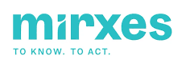



HKEx is an Attractive Listing Venue for International Companies
HK team updated
Hong Kong has been the listing venue of choice for many international companies, i.e. companies with (i) non-PRC founder/parent group background, and/or (ii) with substantial businesses outside of Mainland China
HK listed companies with both non-PRC background and main markets outside of China
Company | Stock Code | Sector | Founder / Parent Co background | Major Markets¹
IFBH LTD | 6603.HK | F&B | Thailand | 92% China; 5% Hong Kong
BUDWEISER BREWING CO APAC LT | 1876.HK | F&B | Belgium | China, South Korea, India, Vietnam
NISSIN FOODS CO LTD | 1475.HK | F&B | Japan | 60% China; 40% Hong Kong/Rest of Asia
SAN MIGUEL BREWERY HK LTD | 236.HK | F&B | Philippines | 55% Philippines; 34% Hong Kong; 9% China
First Pacific Company Limited | 142.HK | Conglomerate | Indonesia | 56% Indonesia; 16% Singapore, 12% Philippines
SAMSONITE GROUP SA | 1910.HK | Apparel | US/ Luxembourg | 37% Asia; 35% North America; 22% Europe
PRADA S.P.A. | 1913.HK | Apparel | Italy | APAC, Europe
AEON STORES HONG KONG CO LTD | 984.HK | Retail | Japan | 54% China; 46% Hong Kong
MGM CHINA HOLDINGS LTD | 2282.HK | Casinos & Gaming | US | Macau
SANDS CHINA LTD | 1928.HK | Casinos & Gaming | US | Macau
WYNN MACAU LTD | 1128.HK | Casinos & Gaming | US | Macau
SOFTCARE LTD | 2698.HK | Personal Care | Dubai | 20% Kenya; 15% Ghana; Senegal 10%, and other African countries
Insilico Medicine | 3696.HK | Biotech | US | 92% US
MIRXES HOLDING CO LTD | 2629.HK | Biotech | Singapore | Singapore, China, Japan, USA
Manulife FINANCIAL CORP | 945.HK | Financials | Canada | 35% Canada; 31% US
HSBC | 5. HK | Financials | UK | 23% Hong Kong, 17% UK
Standard Chartered | 2888.HK | Financials | UK | 24% Hong Kong
Source: Bloomberg; desktop search
% of revenue in latest financial year; % of net premiums for Manulife

Slide 19

























HK Increasingly Attractive for International Issuers
HK team updated
7 International Issuer IPOs Completed in 2025
Upcoming Pipeline
(in US$mn unless specified) | Nanshan Aluminium International | Mirxes | IFBH | Jiaxin International Resources | Zijin SMG International | Softcare | Insilico Medicine
Listing Date (2025) | 25 Mar | 23 May | 30 Jun | 28 Aug | 30 Sep | 10 Nov | 30 Dec
Sector | Industrials – Metal & Mining | Healthcare – Biotech | Consumer – Beverage | Industrials – Metal & Mining | Industrials – Metal & Mining | Consumer – Personal Care | Healthcare – Biotech
Transaction Highlights | 2nd largest aluminium producer in SEA, spun-off from Nanshan Aluminium (600219.SH) | The 1st and only firm with approved IVD products for molecular gastric cancer screening | 2nd largest coconut water player globally, market leader in Hong Kong / China | Tungsten mining company developing the Boguty Project, world’s largest open-pit tungsten mine | Leading SMG mining company, formed through consolidating Zijin Mining’s over-seas SMG assets | 1st Dubai-HQ company with significant MENA business exposure specialising in hygiene products | AI-powered biotech focused on drug discovery and development, with several AI-designed drugs in clinical trials
Home Market | Indonesia | Singapore | Thailand | Kazakhstan | Global | UAE / Africa | US / UAE / Greater China
Deal size / Mkt. Cap. at IPO | 306 / 2,010 | 139 / 825 | 170 / 944 | 177 / 615 | 3,693 / 24,144 | 307 / 1,930 | 293¹ / 1,837¹
Select Cornerstone Investors
Aftermarket (Day-1 / 3-month) | (5.1%) / 19.9% | 28.8% / 87.6% | 42.1% / 9.5% | 177.8% / 206.8% | 68.5% / 101.8% | 26.0% / 23.4%² | 24.7% / 54.4%²
Liquidity - 3M ADTV | 7.4 | 6.4 | 3.3 | 7.4 | 145.7 | 9.4² | 103.5²
Southbound Inclusion |  |  |  | / |  | / | /
4 Active A1 Filings
US
Industrials
UK
Financials
S.Korea
TMT
(Coree)
S.Korea
TMT
+
Jiujiang SASAC
1 Announced
Malaysia
Industrials
Sources: HKEX filings, Bloomberg, Dealogic, Factset market data as of 31 Dec 2025
Pre-shoe
Performance / ADTV since IPO

Slide 20
[Comparison of Listing Vehicle]
Section [ ]

Slide 21
Comparison of Listing Vehicle
HK team updated
 | Company | REIT | Listed active / passive ETF | Alternative Investment Fund ¹
Listing vehicle | Limited company | Unit trust | Unit trust/ OFC | Unit trust/ OFC
Type | Close-ended | Close-ended | Open-ended | Closed-ended
Primary rules reference (excl. FAQ, Guides, Circulars etc.) | Listing Rules, Takeover Code | REIT Code, Listing Rules Chapter 20, Takeover Code | Listing Rules Chapter 20, UT Code, OFC Rules and Code | Listing Rules Chapter 20, UT Code, OFC Rules and Code SFC's "Circular on listed closed-ended alternative asset funds"
Precedent cases of initial public offering | Midea (300.HK) | SF REIT (2191.HK) CMC REIT (1503.HK)
Offering mechanism | 90% international placement, 10% HK public offering, subject to clawback | 90% international placement, 10% HK public offering, subject to clawback | No requirement on geographical location or clawback | No requirement on geographical location or clawback (Procedure(s) and mechanism(s) in place for it to be widely held)
Public float | 25% | 25% | N/A | 25%
Minimum no. of shareholders | 300 | N/A | N/A | "Widely held“ (i.e. 300)
Minimum market cap (HK$ million) | 500 | N/A | N/A | 780
Target yield | Disclosure of dividend policy | Forecast yield of portfolio | Disclosure of dividend policy | Disclosure of dividend policy - no structural decumulation of capital
If Sponsor regime applies, the following would be applicable: Practice Note 21 and Chapter 3A of the Listing Rules and the SFC Code of Conduct (including Chapter 17).
0

Slide 22
Comparison of Listing Vehicle (Cont’d)
HK team updated
Professional Parties involved | Company | REIT | Listed active / passive ETF | Alternative Investment Fund
Sponsor / Listing agent | Sponsor | Listing agent (under sponsor regime) | Listing agent | Listing agent (SFC has discretion to apply sponsor regime)
Manager | No | Yes | Yes | Yes
Investment Adviser | No | Optional | Optional | Optional
Registrar | Yes | Yes | Yes | Yes
Auditor | Yes | Yes | Yes | Yes
Custodian / Trustee | No | Yes | Yes | Yes
Receiving Bank | Yes | Yes | No | No
Fund Administrator | No | No | Yes | Yes
Service Agent / Conversion Agent | No | No | Yes | No - but admission to CCASS required
Participating Dealers | No | No | Yes | No
Market Maker | No | No | Yes | Yes
1

Slide 23
[Comparable Company Analysis]
Section [ ]

Slide 24



Hong Kong Listed Comparable Company Analysis
HK team updated
GDS
SUNeVision
Company Description | A leading provider of cloud-network convergence and digitized IT infrastructure services | The largest carrier-neutral developer and operator of high-performance DCs in China | The technology arm of Sun Hung Kai Properties and the largest DC provider in Hong Kong
Data Centre (“DC”) Locations | Tier 1-2 China cities, Malaysia and with opportunities in SEA | Tier 1-2 China cities, Hong Kong, Singapore, Malaysia, Indonesia | Hong Kong only (Chai Wan, Tseung Kwan O, Sha Tin)
IT Power Capacity | 5GW planned IT capacity, with 2GW in operation/under construction | 1.7 GW total capacity with 3.7 GW reserved for future development | Flagship project in Tseung Kwon O supports 180MW IT power capacity
Number of DCs/DC Area | 36+ DCs | 668,283 m² of data centre in service | ~3,000,000 ft² gross floor area
Key Customers | Top internet/cloud firms (JD.com, Bytedance, Kuaishou Technology, Alibaba Cloud, Tencent, Huawei) | Global hyperscalers & cloud providers (Alibaba, Tencent, AWS, Microsoft) | Financial institutions & APAC cloud firms (HKEX, HSBC, Alibaba Cloud, AWS)
Market Cap (USD’m) | N/A | 6,810.8 | 1,839.2
Revenue (USD’m) | N/A | 1,591.3 | 377.2
Net Profit (USD’m) | N/A | 132.2 | 131.7
Average Power Usage Effectiveness (PUE) | 1.18 PUE | 1.23 PUE | ~1.15 PUE
Source: Z Data website, GDS annual reports and website, SUNeVision annual reports and website, DataCentreMap.com

Slide 25
Hong Kong Listed Comparable Company Analysis (Cont’d)
HK team updated
GDS and SUNeVision are the 2 Hong Kong listed peers that are carrier-neutral IDCs, they are the key comparable company of ZDATA. The telecom players with strong IDC coverage are also included for reference
DBS has research coverage on both GDS and SUNeVision with below insights:
GDS deleverages on track to sustain growth. It is in a good position to capture the growing inference-related DC demand in China, given its high exposure in tier-1 cities. New orders have stabilized from a declining trend, and capex remains stable despite intensifying control over AI chips
SUNeVision reaffirms strong demand with premium portfolio. 1HFY6/26 results temporarily missed expectations due to strict pricing discipline, but strengthening AI demand sets the stage for rapid financial acceleration by FY27. While yield-focused negotiations delayed near-term order confirmations, finalized terms on a major imminent contract and surging regional GPU availability reinforce the company’s dominant long-term growth outlook.
Company Name | Stock Code | Operating Data |  |  |  |  |  | Valuation
 |  | Market Capitalization (USD 'm) | Revenue (USD 'm) | Net Profit (USD 'm) | EBITDA Margin (%) | Revenue Growth (%) | EV (USD 'm) | PE Ratio (x) |  |  | PS Ratio (x) |  |  | EV/EBITDA (x)
 |  |  |  |  |  |  |  | TTM | 2026F | 2027F | TTM | 2026F | 2027F | TTM | 2026F | 2027F
Carrier-Neutral IDCs
GDS Holdings Ltd | 9698 HK Equity | 6,575 | 1,591 | 132 | 45.9% | 10.8% | 11,851 | N/A | 139.1 | 116.4 | N/A | 3.5 | 3.2 | 23.1 | 13.0 | 13.0
SUNeVision Holdings Ltd | 1686 HK Equity | 1,824 | 377 | 126 | 72.4% | 9.9% | 3,992 | 24.0 | 20.9 | 17.3 | 8.3 | 4.5 | 4.0 | 12,8 | 12.8 | 11.6
Telecom Players
China Mobile | 941 HK Equity | 239,159 | 146,176 | 19,082 | 32.3% | 0.9% | 204,209 | 11.8 | 12.1 | 11.7 | 1.5 | 1.5 | 1.5 | 3.6 | N/A | N/A
China Telecom | 728 HK Equity | 77,051 | 73,709 | 4,619 | 27.5% | 0.0% | 72,386 | 13.1 | 13.9 | 13.1 | 0.8 | 1.0 | 1.0 | 2.5 | N/A | N/A
China Unicom | 762 HK Equity | 30,380 | 54,594 | 2,897 | 24.7% | 0.7% | 25,867 | N/A | 10.8 | 10.3 | N/A | 0.5 | 0.5 | N/A | 1.9 | 0.8
 |  |  |  |  |  |  | Max | 24.0 | 139.1 | 116.4 | 8.3 | 4.5 | 4.0 | 23.1 | 13.0 | 13.0
 |  |  |  |  |  |  | Median | 13.1 | 13.9 | 13.1 | 1.5 | 1.5 | 1.5 | 8.2 | 12.8 | 11.6
 |  |  |  |  |  |  | Mean | 16.3 | 39.4 | 33.8 | 3.5 | 2.2 | 2.0 | 10.5 | 9.2 | 8.5
 |  |  |  |  |  |  | Min | 11.8 | 10.8 | 10.3 | 0.8 | 0.5 | 0.5 | 2.5 | 1.9 | 0.8
Source: Bloomberg (27 May 2026), DBS Research

Slide 26
Hong Kong Listed Comparable Company Analysis
HK team updated
GDS
SUNeVision
Current Price | HK$31.86 | HK$6.04
Analyst Consensus Price Target | HK$53.11, representing 66.7% upside | HK$8.42, representing 39.4% upside
Buy | 100% | 100%
Hold | 0% | 0%
Sell | 0% | 0%
Analyst Review Pros |  | SUNeVision’s purpose-built Mega IDC is more preferred by clients SUNeVision’s strong interconnect capability in a major metropolitan hub like Hong Kong better satisfies latency needs SUNeVision’s Mega IDC boasts 180MW of total capacity, enough to support its medium-term growth EBITDA margin remains healthy under its premium pricing power and core locations
Analyst Review Cons |  | Increasing competition and policy rate environment may lead to pricing pressure Significant increase in land supply by HK government may change the current supply-demand dynamics and prompt the firm to alter strategies
Source: Bloomberg (27 May 2026), HSBC Global Investment Research

Slide 27
DBS Credentials
Section 5

Slide 28

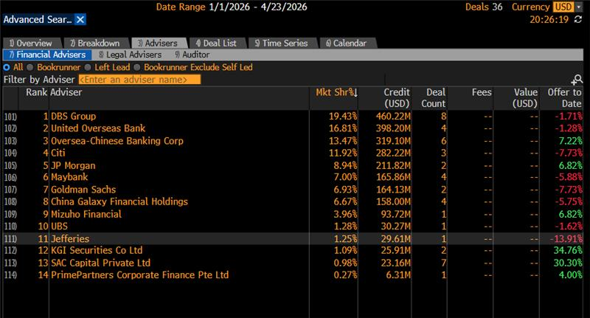
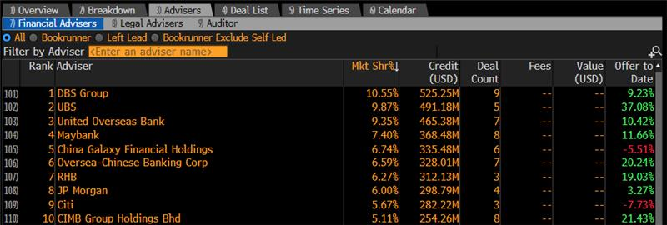
Dominant presence in equity capital markets in Singapore and ASEAN DBS had led-managed ~90% of IPOs and equity fund raisings on SGX between 2021 to 2026 YTD
All Equities League Tables
Best Investment Bank
in Asia Pacific
The Banker
2025 (3rd Consecutive Win)
Best Equity Bank in Asia Pacific
Global Finance
2025 (2nd Win)
Best Investment Bank in Singapore
FinanceAsia
2025 (20th Consecutive Win)
Best Investment Bank in Singapore
Global Finance
2025 (11th Win)
Best ECM House
in Singapore
FinanceAsia
2025 (19th Win)
Best Equity Adviser in Singapore
The Asset
2024
(11th Consecutive Win)
Singapore 2026 YTD
# | Underwriter | Mkt Share | Undrwtn (USD m) | Issues
1 | DBS | 21.8% | 688 | 9
2 | UOB | 19.8% | 626 | 5
3 | OCBC | 17.3% | 547 | 7
4 | CITI | 8.9% | 281 | 3
5 | GALAXY | 8.6% | 271 | 5
6 | JPM | 6.7% | 211 | 2
7 | MAYBAN | 5.2% | 166 | 4
8 | GS | 5.2% | 164 | 2
9 | MIZUHO | 3.0% | 94 | 1
10 | UBS | 1.0% | 30 | 1
Singapore 2025
# | Underwriter | Mkt Share | Undrwtn (USD m) | Issues
1 | DBS | 24.9% | 1,075 | 12
2 | CITI | 18.0% | 774 | 7
3 | UBS | 11.6% | 500 | 5
4 | UOB | 9.9% | 429 | 6
5 | OCBC | 8.3% | 356 | 7
6 | MAYBAN | 5.5% | 236 | 10
7 | JPM | 3.6% | 156 | 1
8 | BofA | 3.6% | 155 | 1
9 | MIZUHO | 3.6% | 155 | 1
10 | MS | 3.5% | 152 | 3
Singapore 2024
# | Underwriter | Mkt Share | Undrwtn (USD m) | Issues
1 | UOB | 21.1% | 505 | 5
2 | JPM | 17.7% | 424 | 2
3 | DBS | 10.2% | 243 | 11
4 | OCBC | 9.7% | 232 | 6
5 | HSBC | 7.6% | 182 | 4
6 | RHB | 6.6% | 158 | 5
7 | CITI | 5.3% | 126 | 3
8 | GS | 4.4% | 106 | 2
9 | UBS | 4.4% | 106 | 2
10 | MS | 2.1% | 51 | 1
Singapore 2023
# | Underwriter | Mkt Share | Undrwtn (USD m) | Issues
1 | DBS | 30.9% | 636 | 12
2 | CITI | 23.6% | 487 | 9
3 | OCBC | 10.0% | 207 | 4
4 | BOFA | 9.6% | 198 | 1
5 | UOB | 7.6% | 157 | 5
6 | JPM | 6.1% | 124 | 1
7 | HSBC | 4.0% | 82 | 3
8 | UBS | 3.7% | 75 | 2
9 | MAYBAN | 1.2% | 25 | 2
10 | RHB | 1.2% | 25 | 2
Singapore 2022
# | Underwriter | Mkt Share | Undrwtn (USD m) | Issues
1 | DBS | 18.2% | 219 | 6
2 | UOB | 16.5% | 199 | 5
3 | OCBC | 11.5% | 138 | 3
3 | CITI | 11.5% | 138 | 3
5 | CS | 7.5% | 90 | 2
6 | CIMB | 6.8% | 81 | 3
7 | KGI | 5.5% | 66 | 2
8 | JPM | 5.1% | 61 | 1
9 | MS | 3.5% | 42 | 1
10 | UOB KH | 3.3% | 40 | 3
Singapore 2021
# | Underwriter | Mkt Share | Undrwtn (USD m) | Issues
1 | DBS | 42.0% | 2,467 | 22
2 | OCBC | 9.4% | 552 | 9
3 | CITI | 6.5% | 383 | 6
4 | BOFA | 6.0% | 352 | 3
5 | HSBC | 5.0% | 295 | 4
6 | JPM | 4.6% | 268 | 4
7 | UBS | 3.8% | 222 | 4
8 | UOB | 3.7% | 215 | 4
9 | CS | 3.6% | 210 | 4
10 | BNPP | 3.4% | 202 | 4
ASEAN 2026 YTD
# | Underwriter | Mkt Share | Undrwtn (USD m) | Issues
1 | DBS | 11.4% | 757 | 10
2 | UOB | 10.5% | 697 | 8
3 | OCBC | 8.4% | 556 | 8
4 | CIMB | 7.0% | 464 | 10
5 | UBS | 6.8% | 452 | 5
6 | GALAXY | 6.7% | 449 | 7
7 | JPM | 6.7% | 448 | 5
8 | MAYBAN | 5.6% | 371 | 8
9 | RHB | 4.8% | 316 | 3
10 | CITI | 4.2% | 281 | 3
ASEAN 2025
# | Underwriter | Mkt Share | Undrwtn (USD m) | Issues
1 | UBS | 12.6% | 1,442 | 15
2 | MAYBAN | 12.1% | 1,338 | 34
3 | CIMB | 7.7% | 884 | 15
4 | DBS | 7.0% | 802 | 10
5 | CITI | 4.6% | 519 | 6
6 | JEFFERIES | 4.3% | 490 | 2
7 | RHB | 3.5% | 399 | 13
8 | OCBC | 3.0% | 343 | 9
9 | TRIMEGAH | 2.8% | 321 | 6
10 | UOB | 2.7% | 306 | 7
ASEAN 2024
# | Underwriter | Mkt Share | Undrwtn (USD m) | Issues
1 | CIMBGR | 15.0% | 1,736 | 32
2 | MAYBAN | 12.6% | 1,461 | 43
3 | UBS | 8.5% | 983 | 17
4 | UOB | 4.4% | 509 | 7
5 | JPM | 4.1% | 473 | 3
6 | NEGIND | 4.1% | 472 | 3
7 | AMINVB | 3.3% | 382 | 15
8 | BofA | 3.0% | 346 | 4
9 | DBS | 2.6% | 304 | 18
10 | BKPH | 2.5% | 292 | 6
ASEAN 2023
# | Underwriter | Mkt Share | Undrwtn (USD m) | Issues
1 | UBS | 7.8% | 925 | 15
2 | MAYBAN | 7.7% | 916 | 39
3 | DBS | 7.7% | 910 | 14
4 | CIMBGR | 6.3% | 748 | 27
5 | CITI | 4.9% | 582 | 10
6 | MANDIR | 4.0% | 472 | 5
7 | CITIC | 3.7% | 437 | 3
8 | HSBC | 3.6% | 425 | 6
9 | NEGIND | 3.4% | 404 | 4
10 | JPM | 3.3% | 393 | 3
ASEAN 2022
# | Underwriter | Mkt Share | Undrwtn (USD m) | Issues
1 | KIAPHA | 6.7% | 775 | 4
2 | CIMB | 5.5% | 645 | 19
3 | SYRUS | 5.4% | 624 | 2
4 | KBANK | 3.6% | 419 | 4
5 | CITIC | 3.5% | 409 | 3
6 | CS | 3.4% | 395 | 8
7 | ING | 3.3% | 381 | 1
8 | DBS | 3.1% | 362 | 10
9 | TRIMEG | 3.1% | 360 | 4
10 | INDO | 2.9% | 336 | 2
ASEAN 2021
# | Underwriter | Mkt Share | Undrwtn (USD m) | Issues
1 | DBS | 9.7% | 2,837 | 27
2 | CS | 7.5% | 2,207 | 21
3 | MANDIR | 6.1% | 1,780 | 6
4 | MS | 5.9% | 1,724 | 11
5 | UBS | 4.8% | 1,409 | 14
6 | JPM | 4.0% | 1,171 | 13
7 | BOFA | 2.8% | 834 | 9
8 | BUANA | 2.8% | 819 | 3
9 | CITI | 2.4% | 719 | 11
10 | MAYBAN | 2.3% | 682 | 13
Source: Bloomberg as at 04 May 2026

Slide 29












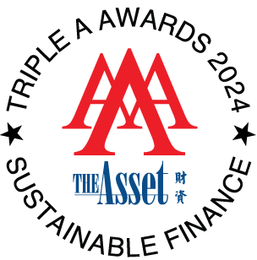
Unrivalled track record of accolades in the investment banking space
The Banker
The Securities Times
Investment Bank of the Year (Asia Pacific)
Best
Investment Bank (Asia Pacific)
Best REIT Adviser in the Region
Best Equity Bank (Asia Pacific)
Best
Innovative Investment Bank in China
DBS has clinched over 100 awards from various publishers in investment banking and equity capital markets including:
2025
Best Investment Bank
(Asia Pacific)
6th Win
2025
Investment Bank
of the Year
(Asia Pacific)
3rd Consecutive Win
2025
Best Investment Bank
(Singapore)
11th Win
2025
Best Investment Bank
(Singapore)
7th Win⁽¹⁾
2025
Best International ECM House – China (Mainland)
2025
Best Bank for Sustainable Finance
(Asia-Pacific)
2024
Best Equity Adviser/House (Singapore)
11th Consecutive
Win
2023 Best Investment Bank
(Indonesia)
The Securities Times
2025
Best Investment Bank
(Singapore)
20th Consecutive
Win
2025
Best Investment Bank (Singapore)
19th Consecutive Win
2024
Best Equity House (Singapore)
19th Consecutive Win
2023
Best REIT Adviser
in the Region
12th Consecutive
Win
2023
Best
Innovative Investment Bank in China
2025
Best Equity Bank (Asia Pacific)
2nd Win
2025
Best ECM House
(Singapore)
19th Win
2025
Investment Bank
of the Year
(FIG)
Source: Publications, DBS internal records as at 31 December 2025
Aggregated with wins for the AsiaMoney Best Bank Awards

Slide 30



DBS’ undisputable track record of successful IPOs on SGX
Our involvement in 16 out of top 20 IPOs on SGX from 2017
DBS consistently commands majority of retail demand for IPOs
 | Issuer Name | Offer Size (S$m) | DBS Involvement
1 | NetLink NBN Trust | 2,347 | ü
2 | NTT DC REIT | 1,004 | ü
3 | UI Boustead REIT | 974 | ü
4 | Prime US REIT | 843 | ü
5 | Digital Core REIT | 827 | ü
6 | Cromwell European REIT | 778 | ü
7 | Centurion Accommodation REIT | 771 | ü
8 | Keppel Pacific Oak US REIT | 762 | ü
9 | Lendlease Global Commercial REIT | 740 | ü
10 | ARA US Hospitality Trust | 622 | ü
11 | UltraGreen.ai | 568 | ü
12 | Nanofilm Technologies International | 510 | -
13 | Daiwa House Logistics Trust | 464 | ü
14 | United Hampshire US REIT | 434 | -
15 | Sasseur Real Estate Investment | 396 | ü
16 | Aztech Global Ltd | 297 | ü
17 | Elite Commercial REIT | 238 | -
18 | Pegasus Asia | 210 | -
19 | Vertex Technology Acquisition | 208 | ü
20 | HRnetgroup Ltd | 174 | ü
Trust
Company
SPAC
Note: IPO Offer Size converted to SGX with prevailing exchange rate at time of IPO
Base offering excludes cornerstone tranche

Slide 31



DBS offers differentiated access to Asian liquidity
Strong Asian momentum is critical for Asian issuers
Early “books covered” message during book-building important to garner broader market buy-in
Asian investors expected to generate the largest investor demand for SGX offerings
DBS' strong and comprehensive Asian investor access can help to generate multi-dimensional demand for price tension
DBS’ institutional sales &
corporate banking franchise
UK
S. Korea
Japan
New York
Myanmar
Taiwan
India
HK/China
UAE
Thailand
Vietnam
Malaysia
Philippines
Singapore
Indonesia
Australia
Global Institutional Sales
in 6 key global financial centres
Corporate Banking, Global Financial Markets in 18 markets across Asia & the region
Large AUM of S$474 billion⁽¹⁾
Tier 1 & 2 funds
Boutique funds
Family offices
Corporate clients including strategics
Foundations / non-profits
Sovereign funds / quasi sovereign
Three platforms serving:
Private Banking clients
Treasures Private clients
Treasures clients
As at September 2025

Slide 32






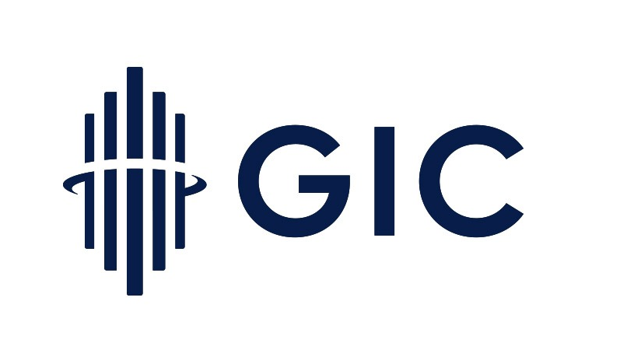

















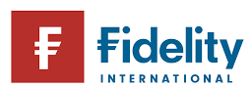














Robust performance in generating cornerstone and anchor demand Strong early demand builds confidence and price leadership
DBS’ ability to bring thought leaders as cornerstones and anchors into the transactions
Procured 6 out of 13 cornerstone investors
Procured 11 out of 16 cornerstone investors
Procured GIC as key cornerstone
US$400m IPO
Healthcare
S$771m IPO
PBWA & PBSA REIT⁽¹⁾
US$1.0b IPO
Data centre REIT
Ong Pang Aik
Achieved highest conversion rate of ~80% with US$636m cornerstone demand
Procured 43% of cornerstone demand – most among banks
Procured 62% of cornerstone demand
Asdew Acquisitions
US$600m IPO
Data centre REIT
S$297m IPO
IOT OEM
S$740m IPO
Retail REIT
Soon Lee Land
Procured bulk of anchor book, accounted for 48% of Day 1 demand
Procured the largest strategic anchor investor
Procured US$230m of cornerstone demand
Large-cap SG-listed real estate corporation owned by a leading Thai conglomerate
S$2.3b IPO
Fibre network
HK$6.6b IPO
TMT
S$2.7b IPO
Healthcare
PBWA refers to purpose-built worker accommodation and PBSA refers to purpose-built student accommodation

Slide 33
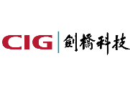
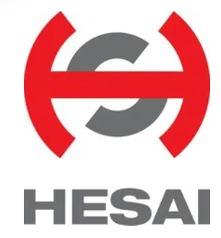



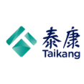























DBS has a Strong Track Record in Introducing Cornerstone and Anchor Investors
HK team updated
Issuer | CIG | HESAI | CommChina | Geek+ | Nanshan Aluminum Intl.
Industry | Communications Technology | Lidar | Cloud Communication Services | Smart Warehouse/AI | Aluminum Industry
Listing Date | October 28, 2025 | September 16, 2025 | July 9, 2025 | July 9, 2025 | March 25, 2025
Listing Location | HKEX | HKEX | HKEX | HKEX | HKEX
Offering Size | USD593 million | USD534 million | HKD413 million | USD345 million | USD302 million
Cornerstone/Anchor Investors Secured by DBS |  |  | Tongzhou International Development Co., Ltd.
Orderbook Demand | DBS received total orders of over US$1.8 bn (i.e. over 3.4x International Offering size) | DBS exclusively introduced the only cornerstone investor with Southeast Asian background, accounting for 7% of the cornerstone demand | DBS brought in 100% of the cornerstone demand and approximately 7.85% of the overall orderbook demand | DBS exclusively brought in long-term institutional investor demand that covered over 60% of the orderbook | DBS brought in over 80% of the foreign institutional investor demand
DBS's Role | Joint Global Coordinator, Joint Bookrunner, Joint Lead Manager | Joint Global Coordinator, Joint Bookrunner, Joint Lead Manager | Sole Sponsor, Overall Coordinator, Joint Global Coordinator, Joint Bookrunner and Joint Lead Manager | Joint Global Coordinator, Joint Bookrunner, Joint Lead Manager | Joint Global Coordinator, Bookrunner, Joint Lead Manager
Issuer | Far East Horizon | JLMAG | Senstime | SF REIT
Industry | Financials | Rare Earth Materials | Artificial Intelligence | Logistics
Listing Date | May 25, 2023 | January 14, 2022 | December 30, 2021 | May 17, 2021
Listing Location | HKEX | HKEX | HKEX | HKEX
Offering Size | USD210 million | USD544 million | HKD5.78 billion | USD351 million
Cornerstone/Anchor Investors Secured by DBS
Orderbook Demand | DBS introduced 100% of the long-term institutional investors and 72% of the overall institutional investor demand | DBS brought in 65% of the cornerstone demand and approximately 50% of the overall orderbook demand | DBS introduced strategic anchor investors and facilitated SenseTime's participation in its AI development layout in Southeast Asia | DBS introduced 56% of the total allocation and 61% of the long-only investors
DBS's Role | Joint Sponsor, Joint Global Coordinator, Joint Bookrunner, Joint Lead Manager | Joint Global Coordinator, Bookrunner, Joint Lead Manager | Joint Global Coordinator, Joint Bookrunner and Joint Lead Manager | Sole Listing Agent, Joint Global Coordinator, Joint Bookrunner, Joint Lead Manager
China SOE
Mixed Ownership Reform Fund

Slide 34


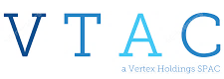

DBS is instrumental in driving demand momentum
DBS constantly outperforms in demand generation across cornerstone and overall book-building
Cornerstone / Anchor
Placement
High Net Worth
IPO year |  | 2026
Market cap |  | S$1.2b
Offer size |  | S$974m
DBS role |  | JIM, JGC & JBR
DBS brought in 27% of cornerstones and bulk of placement demand out of 6 banks
IPO year |  | 2025
Market cap |  | S$1.5b
Offer size |  | S$771m
DBS role |  | JIM, JGC & JBR
DBS brought in 11 of the 16 cornerstones and a majority of the demand, amongst 5 banks
DBS brought in 7 of the 13 cornerstones and a majority of the demand, amongst 3 banks
IPO year |  | 2021
Market cap |  | S$208m
Offer size |  | S$208m
DBS role |  | JIM, JGC & JBR
IPO year |  | 2021
Market cap |  | S$990m
Offer size |  | S$297m
DBS role |  | JGC & JBR
DBS brought in 43% of the cornerstone demand, the largest among all banks
2 cornerstone investors were pre-IPO investors and not considered to be procured by JGCs

Slide 35




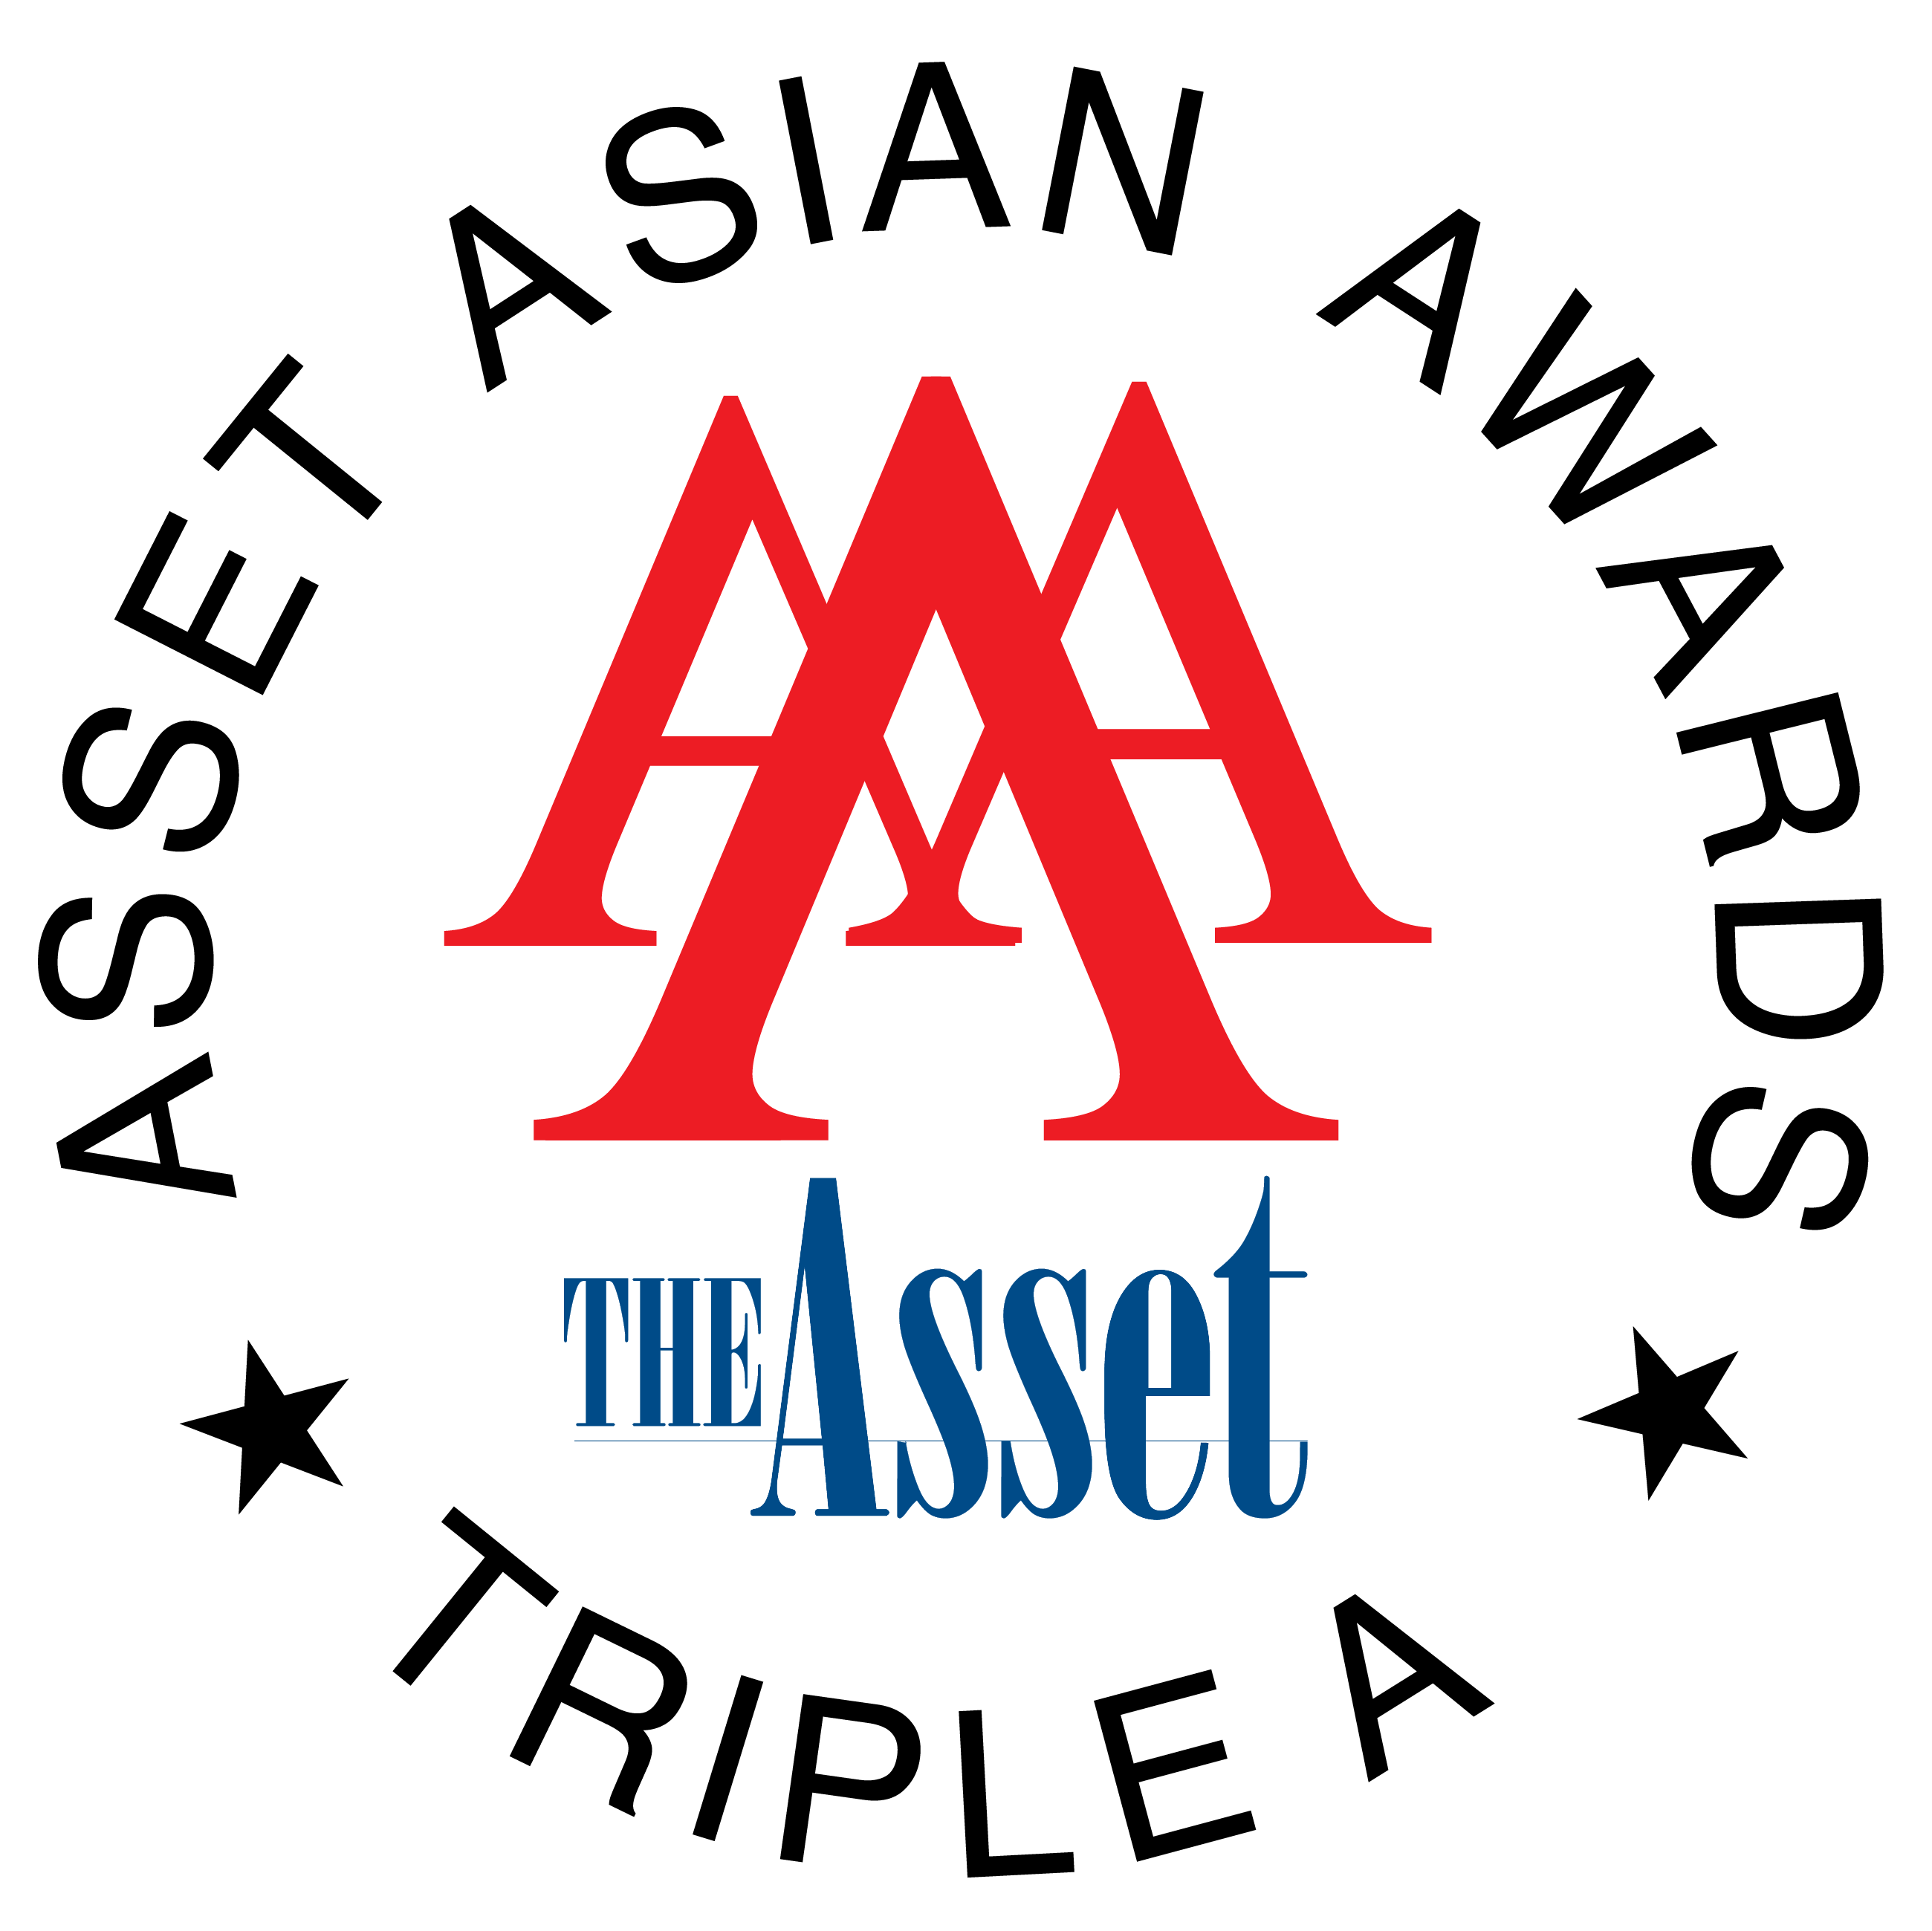

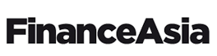


DBS’ Private Wealth clients have been active participants in our REIT IPOs
DBS Private Banking has an extensive network of high networth individuals
Covers major cities including Singapore, Jakarta, Kuala Lumpur, Hong Kong and Beijing
With total AUM of S$426 billion⁽¹⁾
2025
Asia’s Best Private Bank (2023 – 2025)
Best Private Bank (Singapore)
World’s Best for HNW
Overwhelming demand from DBS Private Bank drove 85.3% of the private banking placement demand, far exceeding demand generated by its banking counterparts
Furthermore, DBS dominated retail demand generation for the IPO as it brought in 71% of retail demand in the public offer tranche
PB demand
by bank
2024
World’s Best for HNW
Asia’s Best Private Bank
Singapore’s Best Domestic Private Bank
Best for Family Office Services (Asia)
Best for High Net-Worth Individuals (Asia)
Best Private Bank – Family Offices
Best Private Bank – Asea
Best Wealth Manager – Asia
Best Private Bank – Singapore
Best Private Bank – Hong Kong
DBS Private Bank generated 42.0% of the total demand from high networth investors, which represents a significant step above other banks
This contributed meaningfully to the success of the transaction as PB ultimately contributed almost half (i.e. 45.2%) of the total allocation
2023
Best Private Bank (Singapore UHNW and HNW)
Best Asian Private Bank – Regional
Best Domestic Private Bank – Singapore
Best International Private Bank (Taiwan)
Best Private Bank – Asia-Pacific
Best Private Bank – Asia
Best Private Bank for HNWIs - Asia
PB demand
by bank
DBS Annual Report 2024

Slide 36
















DBS’ proven track record in executing landmark Asian IPOs
S$974 million
IPO
S$771 million
IPO
US$773 million
IPO
IDR10.7 trillion
US$211.3 million
IDR 10 trillion
IPO
IPO
IPO
Joint Issue Manager and Global Coordinator, Joint Bookrunner and Underwriter
Joint Issue Manager and Global Coordinator, Joint Bookrunner and Underwriter
Joint Bookrunner and Underwriter
Joint Global Coordinator, International Selling Agent, Lead Managing Underwriter and Bookrunner
Sponsor, Overall Coordinator, Joint Global Coordinator, Joint Bookrunner and Joint Lead Manager
Domestic Underwriter and Joint Bookrunner
2026
2025
2025
2023
2023
2023
IDR 7.9 trillion
US$600 million
S$464 million
IPO
US$767 million
IPO
IDR5.7 trillion
IPO
US$1.09 billion
IPO
IPO
IPO
Joint Bookrunner and Underwriter
Joint Issue Manager, Global Coordinator, Bookrunner and Underwriter
Sole Financial Advisor, Joint Issue Manager, Joint Global Coordinator, Joint Bookrunner and Underwriter
Joint Global Coordinator and Joint Bookrunner
Joint Bookrunner
Joint Bookrunner and Joint Lead Manager
2022
2021
2021
2021
2021
2021
RMB4.98 billion
IPO
HK$2.59 billion
IPO
US$4 billion
IPO
US$11.2 billion
IPO
S$2.4 billion
IPO
US$884 million
IPO
Financial Advisor and Co-lead Underwriter
Sole Listing Agent, Joint Global Coordinator, Joint Bookrunner and Joint Lead Manager
Joint Bookrunner & Joint Lead Manager
Senior Joint Lead Manager
Joint Issue Manager and Joint Global Coordinator, Joint Bookrunner and Underwriter
Joint Underwriter
2021
2021
2020
2019
2017
2017

Slide 37




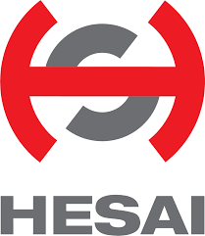













Selected Hong Kong IPO Transactions
HK team updated
IPO
US$111 million
IPO
US$361 million
IPO
US$132 million
De-SPAC IPO
US$23 million
IPO
US$593 million
IPO
US$534 million
IPO
US$442m
IPO
Overall Coordinator, Global Coordinator, Bookrunner, Lead Manager
Joint Bookrunner and Joint Lead Manager
Joint Global Coordinator, Joint Bookrunner and Joint Lead Manager
Overall Coordinator, Joint Global Coordinator, Joint Bookrunner and Joint Lead Manager
Joint Global Coordinator, Joint Bookrunner and Joint Lead Manager
Joint Global Coordinator, Joint Bookrunner and Joint Lead Manager
Joint Lead Manager
May 2026
February 2026
December 2025
November 2025
October 2025
September 2025
July 2025
US$53m
IPO
US$345m
IPO
US$302m IPO
US$749m
IPO
US$60m
IPO
Up to US$700m
Proposed IPO
US$85m
IPO
Sole Sponsor, Overall Coordinator, Joint Global Coordinator, Joint Bookrunner and Joint Lead Manager
Joint Global Coordinator, Joint Bookrunner and Joint Lead Manager
Joint Global Coordinator, Joint Bookrunner and Joint Lead Manager
Joint Bookrunner and Joint Lead Manager
Joint Overall Coordinator, Joint Global Coordinator, Joint Bookrunner and Joint Lead Manager
Joint Bookrunner and Joint Lead Manager
Joint Lead Manager
July 2025
July 2025
March 2025
November 2024
November 2024
October 2024
July 2024
US$84m
IPO
US$270m
IPO
US$29m
IPO
US$500m
IPO
US$210m
IPO
US$540.0m
IPO
US$740.0m
IPO
Joint Overall Coordinator, Joint Global Coordinator, Joint Bookrunner and Joint Lead Manager
Joint Sponsor, Joint Overall Coordinator, Joint Global Coordinator, Joint Bookrunner and Joint Lead Manager
Joint Sponsor, Joint Overall Coordinator, Joint Global Coordinator, Joint Bookrunner and Joint Lead Manager
Joint Global Coordinator, Joint Bookrunners and Joint Lead Manager
Joint Global Coordinator, Joint Bookrunners and Joint Lead Manager
Joint Bookrunner and Joint Lead Manager
Joint Bookrunner and Joint Lead Manager
December 2023
December 2023
December 2023
October 2023
May 2023
Jan 2022
Dec 2021

Slide 38



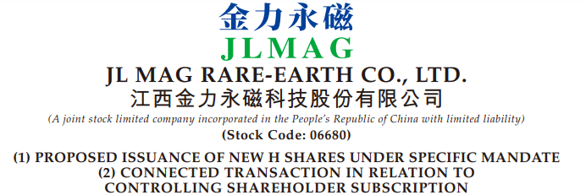

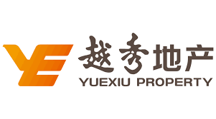






Selected Hong Kong ECM Transactions
HK team updated
Rights Issue / Placement
US$20m Placement
US$53.6m
Placement
US$10m
Placement
Up to US$28m
Placement
US$854m
Rights Issue
US$1.06b
Rights Issue
US$2.4b
Rights Issue
US$507m
Placement and
Rights Issue
Placing Agent and Overall Coordinator
Placing Agent
Sole Placement Agent and Sole Overall Coordinator
Financial Advisor and Placing Agent
Joint Global Coordinator, Joint Bookrunner and Underwriter
Financial Advisor and Joint Underwriter
Joint Lead Underwriter
Financial Advisor
and
Sole Lead Placing Agent
February 2026
August 2025
March 2025
December 2024
November 2023*
June 2023
March 2023
January 2022
Financial Advisor
US$550 million
Asset Disposal
Merger of Haitong Securities and Guotai Junan Securities
US$20 million
Off-market Units Buy-back
US$2,500m
Asset Enhancement Project
US$240m
Acquisition
US$1,250m
Acquisition
US$336m
Spin-off of Infrastructure REIT
US$355m
Acquisition
Financial Advisor
Haitong Securities H-Shares Financial Advisor
Sole Financial Advisor
Financial Advisor
Sole Financial Advisor
Financial Advisor
Financial Advisor
Financial Advisor
September 2025
October 2024
July 2023
January 2023
September 2022
December 2021
December 2021
December 2017

Slide 39
DBS continues to provide research coverage and profile companies in conferences and roadshows post listing
Ongoing research coverage for majority of IPOs that DBS participated
DBS in profiling companies in non-deal roadshows
IPO | Listing exchange | Listing year | Ongoing coverage
UI Boustead REIT | SGX | 2026 | ✓
UltraGreen.ai | SGX | 2025 | ✓
Coliwoo Holdings | SGX | 2025 | ✓
Centurion Accommodation REIT | SGX | 2025 | ✓
NTT DC REIT | SGX | 2025 | ✓
Digital Core REIT | SGX | 2021 | ✓
Daiwa House Logistics Trust | SGX | 2021 | ✓
Aztech Global Ltd | SGX | 2021 | ✓
Lendlease REIT | SGX | 2019 | ✓
Prime US REIT | SGX | 2019 | ✓
Sasseur REIT | SGX | 2018 | ✓
Stoneweg Europe Stapled Trust (fka Cromwell European REIT) | SGX | 2017 | ✓
NetLink NBN Trust | SGX | 2017 | ✓
APAC Realty Limited | SGX | 2017 | ✓
Keppel Pacific Oak US REIT (fka Keppel-KBS US REIT) | SGX | 2017 | ✓
Ongoing profiling of companies via dedicated conferences
Event | Description
DBS Pulse of Asia conference Annual | DBS Vickers flagship event organised for institutional investors and selected corporates across a range of industries
SGX-DBS Jewels of Singapore conference Mar & Sep 2025 | A showcase of selected SGX-listed small and mid-cap companies
Forward Singapore SGX-DBSV conference August 2024 | A showcase of selected SGX-listed blue chip companies and a few selected private companies to institutional investors
Overseas Marketing Efforts in HK, KL, PRC and SG 2023 and 2021 | Organised for institutional investors in the pharmaceutical and biosimilars sectors
Source: DBS Research

Slide 40
Select Case Studies
Section 6

Slide 41
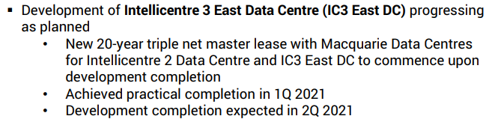

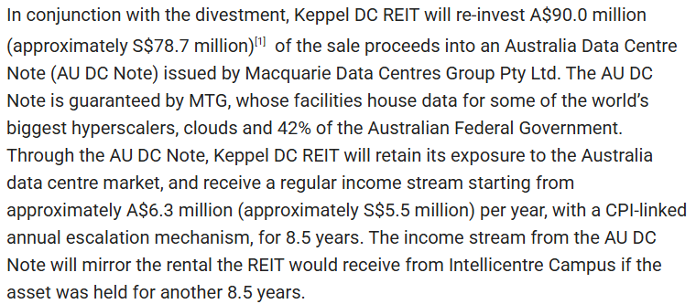
Case Study: Keppel DC REIT grew >4x in the last decade through active management
2025
25 data centres in 10 markets in APAC and EU
S$5.7bn AUM
S$5.8bn Market Cap
4.6% CY2026E DPU yield
KDCREIT enjoys low cost of capital which has fueled a virtuous cycle of funding growth through acquisitions, including participation in DC developments
Notably, over time, it strengthened its portfolio in Singapore
Since 2024, KDCREIT has been active in asset recycling
2025
Divested Basis Bay DC and Kelsterbach DC
2024
Acq KDC Singapore 7 and KDC Singapore 8
Acquired Tokyo DC 1
Divested Intellicentre 2 and 3 East at 35.4% premium and 3.6% exit cap rate, and re-invested part of proceeds to notes issued by acquirer Macquarie Data Centres
Invested in bonds and preference shares issued by M1 Network Private Limited
Acq Guangdong DC
Acquired Eindhoven Campus in Netherlands
Completed development of Intellicentre 3 East in Sydney, commencing 20-year triple net master lease with Macquarie Data Centres
Acq DC1 in Singapore
Acq 99% interest in Keppel DC Singapore 4
Acq London DC in the UK
Acq Guangdong DC 2 and Guangdong DC3 in China
IPO
8 data centres in 7 markets in APAC and EU
S$1.1bn AUM
S$0.82bn Market Cap
6.8% Forecast Year DPU yield
Acq Kelsterbach DC in Germany
Acq Amsterdam DC in Netherlands
Acq maincubes DC in Germany to be developed
Acq Keppel DC Singapore 5
Agreement with Macquarie Telecom to construct Intellicentre 3 East on vacant land
Acq Keppel DC Dublin 2
Acq 90% interest in Keppel DC Singapore 3
Maiden acq of Intellicentre 2 in Sydney
Acq DC in Cardiff
IPO
Total Assets (S$bn)

Slide 42
Case Study: Digital Core REIT – a timeline analysis
Digital Core REIT underperformed the wider FTSE ST REIT Index due to REIT-specific factors, particularly the disruption of business of two of its top tenants in the portfolio
Dec 2021
Jan 2024
Oct 2024
Jun 2025
IPO of DCREIT
Completion of sale of two shell & core facilities in Silicon Valley as part of customer bankruptcy resolution
DCREIT announces recast of loan facilities for the purposes of refinancing existing debt
Jan 2022
Announced that Linton Hall DC was vacant as no replacement tenant had been found
High inflation prints following the COVID-19 pandemic stoke concerns on rising interest rates
Feb 2024
Dec 2024
Price (US$)
DCREIT launches private placement to raise US$100m for Frankfurt and Japan acquisitions
Customer option to renew lease for Linton Hall expired unexercised
Jan 2026
Mar 2022 – Jul 2023
Fed rate hike cycle commences
10-year agreement for lease-up of Linton Hall announced
1H 2022
Apr 2025
Cyxtera (2nd largest tenant) reports ongoing free cash flow deficits and heavy debt
Jun 2023
“”Liberation Day” tariffs announced
Cyxtera files for bankruptcy protection
IPO Offer Price: US$0.88
Apr 2022
Sungard (5th largest tenant) files for bankruptcy protection
Feb 2022
Feb 2023
Nov 2023
Feb 2026
Russia invades Ukraine, sparking an ongoing conflict
Moody’s downgraded Cyxtera’s credit rating to Caa2 from B3
DCREIT announces agreements to resolve customer bankruptcy
US-Iran conflict
Source: FactSet, Bloomberg as at 04 May 2026, REIT Disclosures, Public Announcements

Slide 43

Case Study: NTT DC REIT | U$772.7 million (14 July 2025) Largest REIT IPO on SGX in the last decade
Transaction Overview
Transaction Highlights
Listing date | 14 July 2025
Issuer | NTT DC REIT
Offer type | IPO (Reg-S)
Listing exchange | Listing on the Mainboard of SGX-ST
Market cap at IPO | US$1,030.2 million
Issue size | U$772.7 million ⁽¹⁾ (75.0% of IPO Market cap)
Offer structure | Sponsor Stake: U$257.6 million (25.0% of IPO Market Capitalization) Base Offer: U$772.7 million (75.0% of IPO Market Capitalization) Cornerstone: U$172.8 million (22.4% of Base Offer) Placement: U$569.9 million (73.8% of Base Offer) Retail: U$30.0 million (3.9% of Base Offer or 5.0% of Base Offer ex-Cornerstone)
Cornerstone investors | (1) GIC Private Ltd, (2) AM Squared Ltd, (3) Ghisallo Master Fund LP, (4) Hazelview Securities Inc., (5) Pinpoint Asset Management (Singapore) Pte. Ltd., (6) UBS AG Singapore Branch (on behalf of certain Wealth Management customers), and (7) Viridian Asset Management Ltd.
IPO price | U$1.00 per Unit
Annualized DPU yield | 7.50% (for FY9M25/26) and 7.80% (for FY26/27)
Bank syndicate | DBS, BofA, UBS, Mizuho, Citi
DBS secured a very significant (U$100.8m) cornerstone investment from GIC – the very first investment by GIC in a SGX listed REIT IPO
GIC’s investment was pivotal to the IPO's success, injecting substantial capital to enhance deal certainty and providing critical market validation that significantly boosted investor confidence
Final placement book was approximately 4.0x covered
Allocation was skewed towards the long only investors / real estate specialist funds (47%), and the rest to multi-strategy investors and private wealth
Public Offer was approximately 9.8x subscribed, in spite of the sizable public offer tranche of S$30.0 million and a short (2.5 day) public offering window
Investor Demand
Cornerstone demand by DBS – DBS procured U$100.8m cornerstone demand from GIC
Demand
Allocation
This does not include the Overallotment Option of U$51.5 million

Slide 44
Case Study: Centurion Accommodation REIT IPO (25 September 2025) Strong demand backed by attractive valuation and fundamentals has fuelled stellar market performance
Transaction Overview
Key Positives for Investors
Issuer | Centurion Accommodation REIT (“CAREIT”)
Offer Type | IPO on SGX
Listing Date | 25 September 2025
Sponsor | Centurion Corporation Limited
Sponsor Stake | Approx. 45.8% of market cap (pre over-allotment)
Market Cap | S$1,513.0 million
Offering Price | S$0.88 / unit
Offering Size
Cornerstone Investors | 16 cornerstone investors comprising tier-1 real estate funds, long-only investors and private banks
DPU Yield | Projection Year 2026: 7.47% Projection Year 2027: 8.11%
DBS’ Role | Joint Issue Manager and Global Coordinator, Joint Bookrunner and Underwriter
 | First pure-play S-REIT in the living sector
 | Singapore-focused exposure in a resilient asset class with strong industry demand fundamentals
 | Attractive valuation with low gearing and AEI upsides to drive growth
The IPO saw overwhelming demand
Cornerstone Tranche
70.1%
of IPO size
Placement Book
16.0x
covered
Retail Offering
30.9x
subscribed
 | Offering Size (S$m) | % of Total Offering
(i) Cornerstone | 540.4 | 70.1%
(ii) Offering:
Placement Tranche | 219.1 | 28.4%
Public Offer Tranche | 11.6 | 1.5%
Total | 771.1 | 100.0%
Since IPO, Centurion Accommodation REIT is up 20.5%
Price (S$)
CAREIT Price Performance (YTD since IPO on 25 September 2025)
Turnover (S$m)
FIL
abrdn Asia
Amova
Asdew Acq
B&I Capital
Barings
Cohen & Steers
DBS Bank
DBS PB
DWS Eastspring
Lion Global
Mr Ong Pang Aik
PGI Singapore
UBS PB
Value Partners
CY2026 DPU Yield: 7.47%
Equivalent CY2026 DPU Yield: 6.20%
Source: Bloomberg as at 14 Nov 2025, Centurion Accommodation REIT Publications

